Slide 1

Gokaraju Rangaraju Institute of Engineering and Technology
(Autonomous)
Department of Artificial Intelligence and Machine Learning Engineering
MINI PROJECT
Handwritten Text Recognition using LMDB
Presented by:
1. Vyshnavi Vasikarla (21241A6663)
2. Katkuri Anushna (21241A6636)
3. Alladi Sanjana (21241A6604)
Under the Guidance of
Ms. K. Mounica Souwmya
Assistant Professor

Slide 2
Abstract
Handwritten Text Recognition (HTR) tackles identifying handwritten text from digital images, facing challenges due to diverse handwriting styles. LMDB (Lightning Memory-Mapped Database) is a high-performance open-source key-value database system, adept at memory-mapping for fast data access without disk I/O overhead. In HTR, LMDB's speed aids in storing and retrieving large datasets efficiently, enhancing feature extraction and recognition processes. LMDB's design aligns with the demands of HTR, facilitating seamless integration and optimal performance in handling diverse handwriting styles.

Slide 3
Problem Statement
Handwritten Text Recognition (HTR) requires overcoming the variability in handwriting styles to accurately transcribe handwritten content from digital images into machine-readable text, essential for applications across multiple domains.

Slide 4
Objectives of the Project
To integrate LMDB into the HTR system for optimized data storage, retrieval, and training, thereby improving overall performance.
To compare the performance of the LMDB-enhanced HTR system against existing methods, highlighting improvements in accuracy and efficiency.
This project focuses on leveraging LMDB (Lightning Memory-Mapped Database) technology to enhance the accuracy and efficiency of HTR systems.
By integrating LMDB technology into the HTR system, this project seeks to harness the benefits of efficient data storage, optimized retrieval, reduced computational overhead, and scalability to enhance the accuracy and efficiency of handwritten text recognition.

Slide 5
Existing Approaches (Literature Survey)
Reference Number | Title | Objective | Methodology | Accuracy | Pros | Research Gap
[1] | A Survey on Handwritten Character Recognition | to automatically recognize handwritten Hindi characters. | artificial neural networks (ANN) and their variants. | The accuracy of the system is expected to be dependent on the quality of the templates and the matching algorithm used. | The system may be relatively simple and efficient, as it does not require complex preprocessing or feature extraction techniques. | The document may identify limitations of the template matching approach, such as sensitivity to variations in handwriting style, and suggest potential improvements or alternative methods. Title: Handwritten Digit Recognition with a Back-Propagation Network
[2] | A Novel Method of Handwritten Character Recognition Using Template Matching | to recognize handwritten characters of any arbitrary size and shape | Template Matching | in the beginning the error rate was roughly 27% which in the 6th iteration was reduced to 8% | The adaptability of templates allows the system to dynamically adjust to individual writing styles. | Further research could focus on improving the robustness and accuracy of template matching for handwritten character recognition.

Slide 6
Reference Number | Title | Objective | Methodology | Accuracy | Pros | Research Gap
[3] | The adaptability of templates allows the system to dynamically adjust to individual writing styles. | to recognize on-line handwritten characters accurately.Combines both pen-direction feature and pen-coordinate feature to describe the shape variation of on-line characters. | Hidden Markov Models(HMMs) | Not specified. | Combining Pen-Coordinate and Pen-Direction Features | The paper suggests that the method can be used for text recognition in images with varying display sizes and content.
[4] | Handwritten Digit Recognition with a Back-Propagation Network | The focus was on direct image-based recognition without complex preprocessing. | Convolutional Neural Networks (CNNs) Back-Propagation Networks (BP Networks) | The system achieved a 1% error rate and about a 9% reject rate on zipcode digits provided by the U.S. Postal Service. | The system is efficient and effective, demonstrating the potential of large back-propagation networks for real image-recognition problems. | The document may discuss the limitations of the system, such as the need for a large, complex preprocessing stage, and suggest potential improvements or alternative methods. Title: Handwritten Text Recognition using Deep Learning Algorithms

Slide 7
Reference Number | Title | Objective | Methodology | Accuracy | Pros | Research Gap
[5] | Offline Handwriting Recognition with Multidimensional Recurrent Neural Networks | to tackle the challenging task of offline handwriting recognition—the automatic transcription of images of handwritten text. | Multidimensional Recurrent Neural Networks (MD-RNNs) | 91.4% | International Success | Further research could focus on improving the system's accuracy and robustness in recognizing handwritten text.
[6] | Handwriting Recognition with Large Multidimensional Long Short-Term Memory Recurrent Neural Networks | introduces an efficient GPU-based implementation for handwriting recognition using multidimensional long short-term memory recurrent neural networks (MDLSTM-RNNs) | multidimensional long short-term memory recurrent neural networks (MDLSTM-RNNs) | System WER[%]:9.6 System CER[%]: 2.8 | Diagonal-Wise Processing, Efficient GPU-Based Implementation | The system can be extended to handle more complex scenarios, such as recognizing text in different languages or in low-quality images.

Slide 8
Reference Number | Title | Objective | Methodology | Accuracy | Pros | Research Gap
[7] | Show, Attend and Tell: Neural Image Caption Generation with Visual Attention | To present a deep learning approach for recognizing handwritten text using a semi-supervised generative adversarial network (GAN) called ScrabbleGAN. | Attention Mechanisms | The system achieved a 97.1% character recognition accuracy on a test set of handwritten text. | The use of ScrabbleGAN allows for the generation of synthetic handwritten text, potentially improving the robustness and generalization of the recognition system. | The document may identify limitations of the system, such as the need for large datasets and computational resources, and suggest potential improvements or alternative methods.
[8] | Deep Hand: How to Train a CNN on 1 Million Handwritten Characters | To present a machine learning model for recognizing handwritten characters on form document. | End-to-End Models | The system achieved a 94.6% recognition accuracy on a test set of form documents. | The system is efficient and effective, demonstrating the potential of CNNs for handwritten character recognition on form documents. | Research could focus on improving the system's accuracy and robustness in recognizing handwritten text.

Slide 9
Reference Number | Title | Objective | Methodology | Accuracy | Pros | Research Gap
[9] | A Novel Connectionist System for Unconstrained Handwriting Recognition | an alternative approach to handwriting recognition using a novel type of recurrent neural network (RNN) specifically designed for sequence labeling tasks where the data is hard to segment and contains long-range bidirectional interdependencies | hidden Markov model (HMM)-based system | Online Data: 79.7% accuracy Offline Data: 74.1% accuracy | Robustness to Unconstrained Handwriting, In-Depth Analysis and Comparison with HMMs | The need for large, complex preprocessing stages in image recognition systems.
[10] | Rosetta: Large Scale System for Text Detection and Recognition in Images | The primary purpose of Rosetta is to process images uploaded daily at Facebook scale | scalable optical character recognition (OCR) system called Rosetta | The system achieves high accuracy in text detection and recognition, with extensive evaluation performed to ensure its performance. | Discusses modeling techniques for efficient text detection and recognition in images, provides insights into building an OCR system at scale, and shares practical lessons learned during the development and deployment of Rosetta. | Further research can be done to improve the system's accuracy, efficiency, and robustness. Additionally, the system can be extended to handle more complex scenarios, such as recognizing text in different languages or in low-quality images.

Slide 10
Reference Number | Title | Objective | Methodology | Accuracy | Pros | Research Gap
[11] | Labeling Lines with a Recurrent Neural Network | To provide a detailed description of the use of recurrent neural networks (RNNs) for supervised sequence labelling tasks, including the use of the truncated gradient and the exact gradient for backpropagation through time. | recurrent neural network (RNN) | The accuracy of the proposed approach is not explicitly stated in the provided text. | The use of RNNs allows for the modelling of long-range dependencies in sequence data, and the use of the exact gradient for backpropagation through time makes the training process more robust and easier to debug. | The document may discuss the limitations of the system, such as the need for large datasets and computational resources, and suggest potential improvements or alternative methods.
[12] | Scene Text Recognition with Sliding Convolutional Character Models | To address scene text recognition, a task that has garnered significant interest in the computer vision and pattern recognition community. They proposed a novel method that leverages character models on convolutional feature maps. | Sliding Convolutional Character Models Character Classifier and CTC Decoding Concolutional neural networks (CNNs), recurrent neural networks with long short-term memory (RNN-LSTM) | 81.7 | 1.No Character Segmentation: 2.Efficient Training 3.Lexicon-Free Recognition 4.Parallel and Fast Recognition | The authors suggest that further research can be done to improve the system's accuracy, efficiency, and robustness.

Slide 11
Reference Number | Title | Objective | Methodology | Accuracy | Pros | Research Gap
[13] | ResNet + CTCLoss: A Simple, Dense and Accurate Neural Network Architecture for Offline Handwritten Text Recognition | a novel neural network architecture that combines the strengths of Residual Networks (ResNet) and the Connectionist Temporal Classification (CTC) loss. | Residual Networks (ResNet), CTCLoss | 85.6% | The system is efficient and effective, demonstrating the potential of fully convolutional networks for handwritten text recognition. | The document may identify limitations of the system, such as the need for a large dataset of form documents for training, and suggest potential improvements or alternative methods.
[14] | Towards Robust Curve Text Detection with Conditional Spatial Expansion | to address the challenging task of curve text detection in natural scene images. | Maximally Stable Extremal Regions (MSERs), Single-Link Clustering, Character and Text Classification | 71% | The method is more robust and enjoys a simpler processing flow compared with existing curve text detection algorithms. | The document may discuss the limitations of the system, such as the need for large datasets and computational resources, and suggest potential improvements or alternative methods.

Slide 12
Reference Number | Title | Objective | Methodology | Accuracy | Pros | Research Gap
[15] | Multi-Oriented Scene Text Detection via Corner Localization and Region Segmentation | to address the challenging task of multi-oriented scene text detection in natural scene images | General Object Detection Paradigm, Direct Text Region Segmentation, Localizing Corner Points, Segmenting Text Regions | 84.3% on ICDAR2015 and 81.5% on MSRA-TD5001. | The method can handle long oriented text naturally and doesn't need complex post processing. | he document may discuss the limitations of the system, such as the need for complex preprocessing and the sensitivity to the quality of the input images, and suggest potential improvements or alternative methods.
[16] | MORAN: A Multi-Object Rectified Attention Network for Scene Text Recognition | to address the challenging task of general scene text recognition, particularly focusing on irregular text. | Multi-Object Rectification Network (MORAN): | 84.3% on ICDAR2015 and 81.5% on MSRA-TD5001. | The use of a multi-object rectification network allows for the generation of synthetic handwritten text, potentially improving the robustness and generalization of the recognition system. | The document may discuss the limitations of the system, such as the need for large datasets and computational resources, and suggest potential improvements or alternative methods.

Slide 13
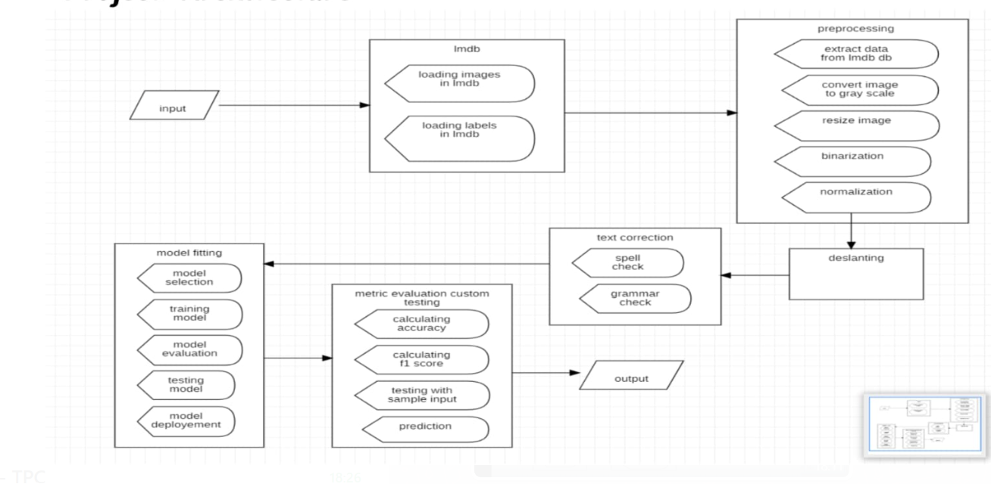
Architecture Diagram

Slide 14
Description of Architecture Diagram
Input Image: The architecture starts with an input image containing handwritten text. This image can be obtained from various sources such as scanned documents, images captured from cameras.
Preprocessing Module: The input image goes through a preprocessing module to enhance its quality and make it suitable for recognition. Preprocessing steps may include noise removal, binarization, resizing and normalization.
Feature Extraction: In this step, the preprocessed image is analyzed to extract relevant features that can help in recognizing the text content. Features may include strokes, contours, edges, and other patterns that are characteristic of handwritten text. Techniques for feature extraction include Convolutional Neural Networks (CNNs)
LMDB Database: LMDB is used as the database backend to store the extracted features along with their corresponding labels or ground truth text. LMDB provides efficient storage and retrieval of key-value pairs and is particularly well-suited for high-throughput applications like machine learning.
Training Module: The extracted features and their corresponding labels are used to train a machine learning model for handwritten text recognition. This module typically involves a deep learning architecture such as a Convolutional Recurrent Neural Network (CRNN) or a Transformer-based model. The model learns to map input features to their corresponding textual representations.
Validation and Testing: A portion of the labeled data is kept aside for validation and testing purposes. The trained model is evaluated using this data to measure its performance metrics such as accuracy, precision, recall, and F1-score.
Output: The final output of the system is the recognized text obtained from the handwritten input image. This text can be further processed or integrated into downstream applications as needed.

Slide 15
Dataset Details
The dataset for handwritten text recognition (HTR) using LMDB typically consists of images containing handwritten text along with corresponding text labels. The dataset varies in size and may include thousands to millions of images with diverse writing styles, languages, and fonts. Before training, the dataset undergoes preprocessing to standardize images and labels, and data augmentation may be applied for improved model generalization. The dataset is stored in LMDB format for efficient storage and retrieval during training. It is divided into training, validation, and test sets, and popular datasets include IAM Handwriting Database, MNIST (for digit recognition), RIMES, CEDAR, and CTC-OCR datasets, catering to different languages and scripts.

Slide 16
Software & Hardware Requirements
Hardware Requirements:
Software Requirements:
1.GPU: Depending on the scale of the project, a CPU or GPU with sufficient processing power for training and inference.
2.Memory: Adequate RAM for storing image data and model parameters during training and testing.
3.Storage: Sufficient disk space for storing datasets, model checkpoints, and other project-related files.
4.Display: A monitor for visualizing data and results during development and testing.
1.Image processing libraries (e.g., OpenCV) for pre-processing handwritten images.
2.Machine learning frameworks (e.g., TensorFlow) for training and deploying recognition models.
3.Text processing libraries (e.g., NLTK, SpaCy) for post-processing recognized text.
4.Development environment (e.g., Python IDE) for coding and experimentation.

Slide 17
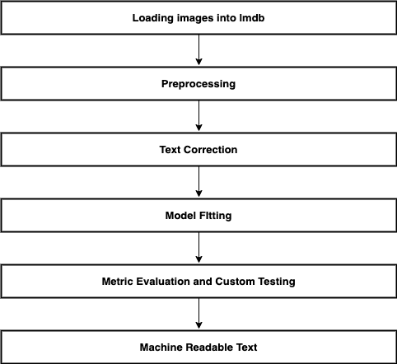
Modules Connectivity Diagram

Slide 18
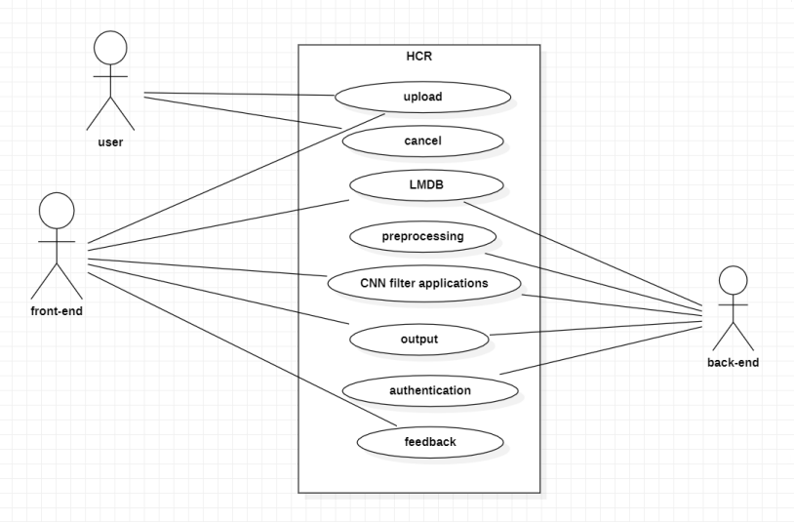
Use Case Diagram

Slide 19
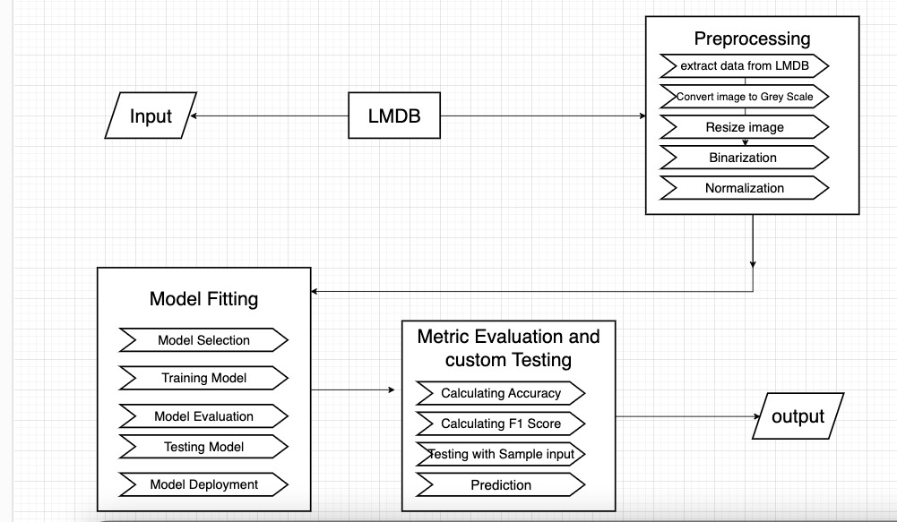
Data Flow Diagram

Slide 20
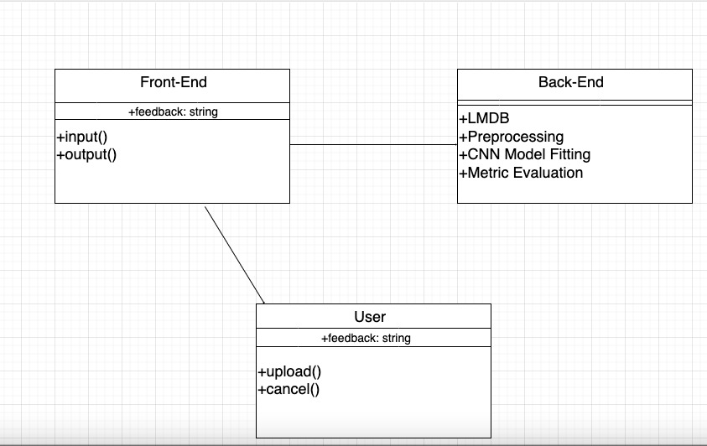
Class Diagram

Slide 21
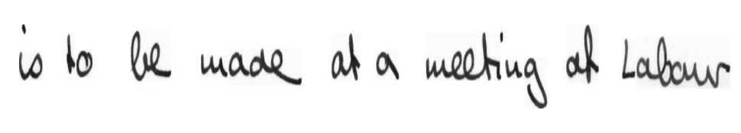
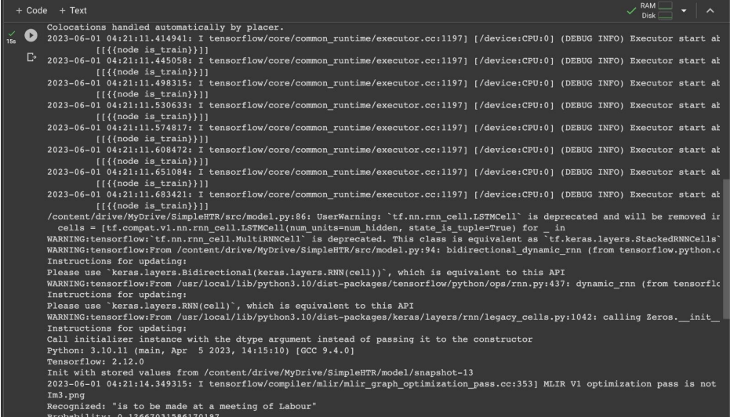
Experimental Results
Input Image :
Output :

Slide 22
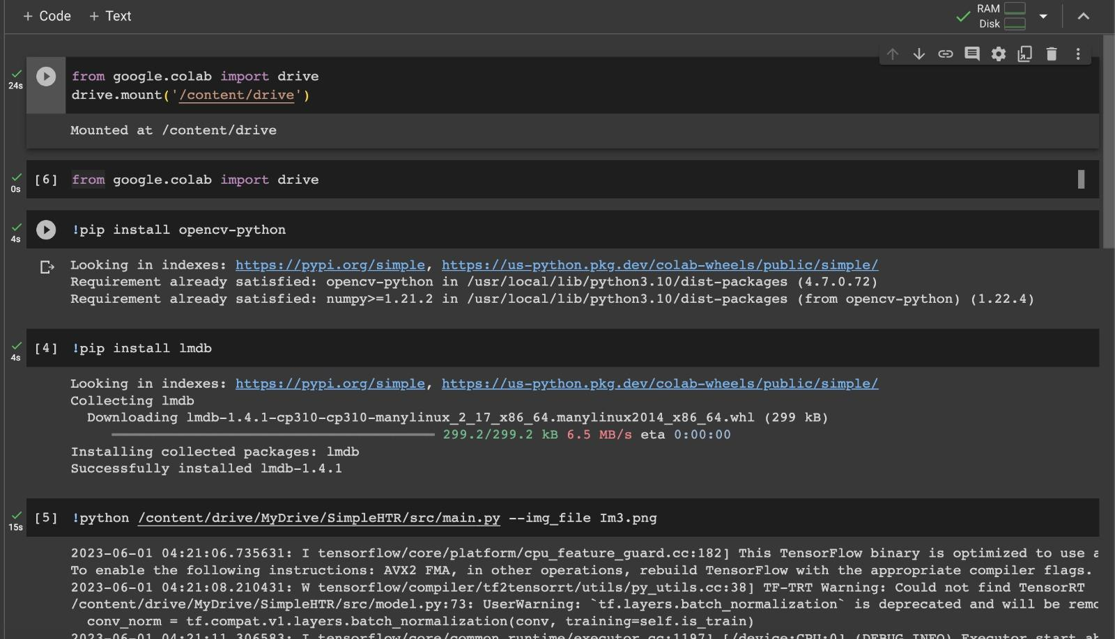
Screenshots of Results

Slide 23
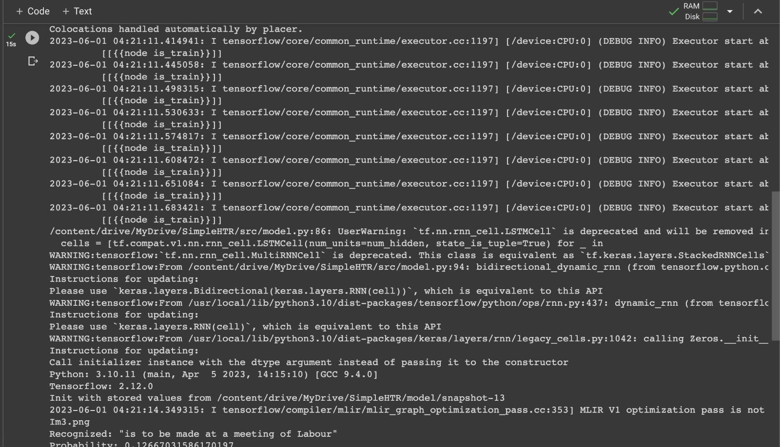
Screenshots of Results

Slide 24
Significance of Proposed Work
Handwritten text detection plays a crucial role in today's digital world. The proposed word-level handwritten text recognition using LMDB (Lightning Memory-Mapped Database) leverages a high-performance key-value store to enhance the efficiency and scalability of training deep learning models. LMDB's memory-mapped files allow for faster data retrieval and reduced I/O bottlenecks, critical for handling large handwriting datasets. This approach supports robust, real-time data augmentation and ensures efficient data access patterns, crucial for training accurate recognition models. By minimizing latency and maximizing throughput, it accelerates the learning process, making it suitable for large-scale, high-resolution handwriting recognition tasks.

Slide 25
Conclusion
In conclusion, handwritten text detection plays a crucial role in today's digital world. As a result of accurately identifying and extracting handwritten content from images, it facilitates efficient digitization, data analysis, and information retrieval. A wide range of applications can be achieved with this technology, including document digitization and archiving, automatic transcription, and intelligent character recognition. With advancements in machine learning and computer vision, handwritten text detection systems have become increasingly accurate and reliable. In addition to saving time and effort, they pave the way for innovative solutions in various fields, including education, healthcare, and finance. With continuous refinement and improvement, handwritten text detection technology will continue to enhance its capabilities and impact in the future.

Slide 26
Future Enhancements
➢ Digitization: Handwritten text recognition can play a crucial role in the digitization of historical documents, archives, and manuscripts. By automating the process of converting handwritten texts into digital format, valuable information can be preserved, accessed, and searched more easily.
➢ Intelligent Assistants: HTR can enhance the capabilities of intelligent assistants and chatbots. By accurately interpreting and transcribing handwritten notes or messages, these assistants can better understand and respond to user queries, enabling more seamless and natural interactions.
➢ Note Taking and Transcription: HTR can be integrated into note-taking applications, allowing users to write or sketch their ideas on digital devices while the system automatically converts their handwritten input into editable text. This can be beneficial for students, professionals, and anyone who prefers handwritten notes but requires them in a digital format.
➢ Form Processing: HTR can streamline form processing tasks by automatically extracting information from handwritten forms. This can be useful in various sectors such as healthcare, finance, and administration, where handwritten forms are still prevalent.

Slide 27
References
1. Graves, A., Liwicki, M., Fernandez, S., Bertolami, R., Bunke, H., & Schmidhuber, J. (2009). "A Novel Connectionist System for Unconstrained Handwriting Recognition". IEEE Transactions on Pattern Analysis and Machine Intelligence, 31(5), 855-868.
2. Breuel, T. M. (2013). "High-Performance OCR for Printed English and Fraktur using LSTM Networks". In Proceedings of the International Conference on Document Analysis and Recognition (ICDAR), 683-687.

Slide 28
References
3. Borisyuk, F., Gordo, A., & Sánchez, J. A. (2018). "Rosetta: Large Scale System for Text Detection and Recognition in Images". In Proceedings of the European Conference on Computer Vision (ECCV), 786-802.
4. Rodriguez-Serrano, J. A., Perronnin, F., & Meylan, F. (2018). "Labeling Lines with a Recurrent Neural Network". In Proceedings of the IEEE Conference on Computer Vision and Pattern Recognition (CVPR), 8120-8129.

Slide 29
References
5. Borisyuk, F., Gordo, A., & Sánchez, J. A. (2019). "Scene Text Recognition with Sliding Convolutional Character Models". In Proceedings of the IEEE International Conference on Computer Vision (ICCV), 4156-4165.
6. Ghosh, S., Krishnan, P., & Bhattacharya, U. (2018). "ResNet + CTCLoss: A Simple, Dense and Accurate Neural Network Architecture for Offline Handwritten Text Recognition". arXiv preprint arXiv:1812.07932.

Slide 30
References
7.Shi, B., Yang, M., Wang, X., Lyu, P., Yao, C., & Bai, X. (2017). "ASTER: An Attentional Scene Text Recognizer with Flexible Rectification". IEEE Transactions on Pattern Analysis and Machine Intelligence, 41(9), 2035-2048.
8. Huang, W., Qiao, Y., & Tang, X. (2014). "Robust Scene Text Detection with Convolutional Neural Networks Induced MSER Trees".

Slide 31
References
9. Gupta, A., Vedaldi, A., & Zisserman, A. (2016). "Synthetic Data for Text Localisation in Natural Images". In Proceedings of the IEEE Conference on Computer Vision and Pattern Recognition (CVPR), 2315-2324
10. Yin, X., Yin, X., Huang, K., & Hao, H. (2019). "Towards Robust Curve Text Detection with Conditional Spatial Expansion". In Proceedings of the IEEE Conference on Computer Vision and Pattern Recognition (CVPR), 8814-8823.

Slide 32
References
11. Luo, Z., Hao, S., Hu, Y., & Tian, S. (2019). "MORAN: A Multi-Object Rectified Attention Network for Scene Text Recognition". In Proceedings of the IEEE Conference on Computer Vision and Pattern Recognition (CVPR), 5380-5389.
12. Jaderberg, M., Simonyan, K., Vedaldi, A., & Zisserman, A. (2015). "Deep Structured Output Learning for Unconstrained Text Recognition". In Proceedings of the International Conference on Machine Learning (ICML), 369-377.

Slide 33
References
13. Jaderberg, M., Vedaldi, A., & Zisserman, A. (2014). "Deep Features for Text Spotting". In Proceedings of the European Conference on Computer Vision (ECCV), 512-528.
14. Shi, B., Wang, X., & Bai, X. (2016). "Robust Scene Text Recognition with Automatic Rectification". In Proceedings of the IEEE Conference on Computer Vision and Pattern Recognition (CVPR), 4168-4176.

Slide 34
References
15. Busta, M., Neumann, L., Matas, J., & Tajine, M. (2017). "Deep TextSpotter: An End-to-End Trainable Scene Text Localization and Recognition Framework". In Proceedings of the IEEE International Conference on Computer Vision (ICCV), 2223-2231.

